Slide 1
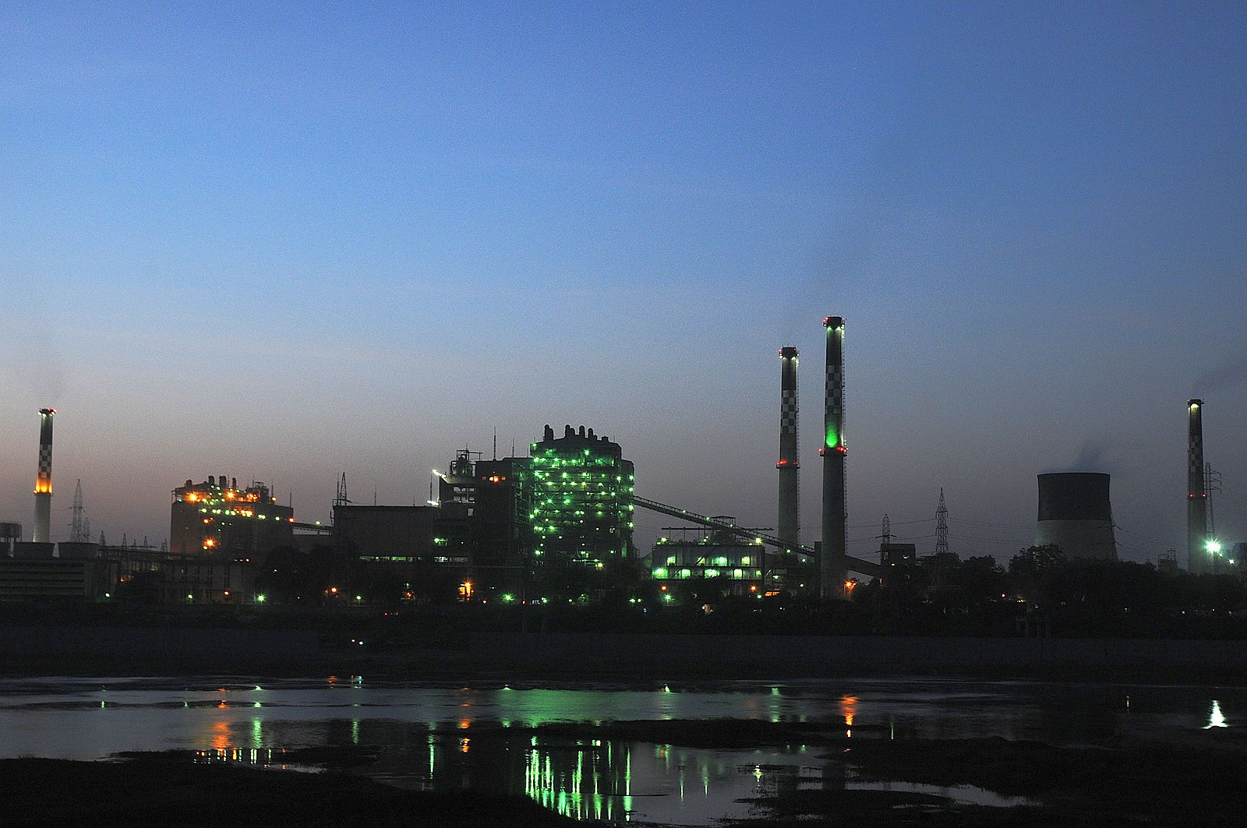

Market Analysis of Torrent Power Ltd.
Economics Project-2, Group-2

Slide 2
SWOT Analysis of Torrent Power with USP, Competition, STP (Segmentation, Targeting, Positioning) - Marketing Analysis
Torrent Power
Parent Company | Torrent Group
Category | Power
Sector | Energy
Tagline/Slogan | Transforming Life
USP(Unique, Selling, Proposition) | An experienced Group in Financing Projects

Slide 3
STP (Segmentation, Targeting, Positioning)
STP
Segment | Retail and commercial customers looking for power
Target Group | Industries, residential complexes, commercial complexes
Positioning | Efficient and Reliable

Slide 4
SWOT Analysis of Torrent Power Ltd.
Strengths | 1. Successful in Private distribution franchisee business 2. Very low debt to equity ratio thus minimizing exposure to risk 3. High efficiency of generation and also of transmission and distribution 4. Integrated across the value chain – Generation, Transmission and Distribution
Weaknesses | 1. Presence restricted to few states 2. Unlike other firms, Torrent Power does not possess sources of coal or oil and hence incapable of doing Backward Integration.
Opportunities | 1. Huge scope in the private power sector and scope to enter new markets in India. 2. Scope to expand its franchisee business 3. Scope to enter the T&D business in other states
Threats | 1. May face opposition from local State Electric Boards 2. Delays in transportation of imported gas and also delay in the KG-D6 basin gas project may have a negative impact – may create shortages

Slide 5
Factors determining market structure
No. of Buyers & Sellers
Nature of Commodity
Freedom of movement of firms
Mobility of Goods & Factors of Production
Knowledge of market conditions
Based on Region

Slide 6
Number of Buyers and Sellers
Number of buyers and sellers of a commodity in the market indicates the influence exercised by them on the price of the commodity.
There is a lot of variety in the buyers of electricity including residential, commercial, and agricultural.
The number of buyers are many whereas there is only a single seller i.e. Torrent Power Ltd., in Ahmedabad.
Torrent Power transmits and distributes over 4 billion units of power per annum to its 1.26 million customers spread over 293 Sq. Kms. in Ahmedabad and 63 Sq. Kms. in Gandhinagar.

Slide 7
Nature of the Commodity
If the commodity is identical in all respects, then it is sold at a uniform price. However, if the commodity is of differentiated nature (for e.g. : brands of soap), then it may be sold at different prices. If the commodity has no close substitutes (like electricity), then the seller can charge higher price from the buyers.
In today’s scenario, electricity has become a basic necessity of humans and thus, there is no option for the buyers of Ahmedabad other than buying it from Torrent Power Ltd.
In case of Torrent Power Ltd., although it is the only seller of electricity in Ahmedabad region, the price is regulated by GERC as per government norms.

Slide 8
Freedom of Movement of Firms
If there is freedom of entry and exit of firms, then price will be stable in the market. However, if there are restrictions on entry of new firms and exit of old firms, then a firm can influence the price as it has no fear of competition from other or new firms.
Production and distribution of electricity is a highly regulated business and only a selected number of firms can join this industry only if the high amount of capital required is feasible for them.
Furthermore, the risk factor is also high because if the organization doesn’t succeed in fulfilling the demand, a large amount of capital can go to loss. Other threats include competition by renewable sources of energy and natural calamities.

Slide 9
Knowledge of Market Conditions
If buyers and sellers have perfect knowledge about the market conditions, then a uniform price prevails in the market. However, in case of imperfect knowledge, sellers are in a position to charge different prices.
In the case of electricity, the consumer doesn’t have proper knowledge about the cost of electricity. Furthermore, even though Torrent Power has a monopoly, GERC regulates the electricity tariff and therefore, Torrent cannot raise the price of electricity if it wishes.

Slide 10
Mobility of Goods and Factors of Production
When the factors of production can move freely from one place to another, then a uniform price prevails in the market. However, in case of immobility of goods and factors, different prices may prevail in the market.
Electricity is generated and distributed in real time i.e. it is never stored and hence, it requires high maintenance. The Power Factor also needs to be maintained by Torrent Power to make sure the cost of production doesn’t rise.
Fuel Costs are a major factor of production. Torrent Power purchases a large amount of coal from Indonesia hence, import duties add up to the cost of production.

Slide 11
Market Analysis Based on Region
Torrent Power Ltd. enjoys a monopoly in Ahmedabad as there are no competitors.
However, different parts of Gujarat are supplied electricity by different companies.
1 Gujarat Urja Vikas Nigam Ltd. (GUVNL)
2 Gujarat State Electricity Corp. Ltd.(GSECL)
3 Gujarat Energy Transmission Corp. Ltd.(GETCO)
4 Uttar Gujarat Vij Company Ltd. (UGVCL)
5 Dakshin Gujarat Vij Company Ltd. (DGVCL)
6 Madhya Gujarat Vij Company Ltd. (MGVCL)
7 Paschim Gujarat Vij Company Ltd. (PGVCL)
8 Torrent Power Ltd

Slide 12
Hence in the state the market of torrent power is similar to that of oligopoly market.
Features of oligopoly market and its relation to torrent power:
1. Few firms: In Gujarat as seen above there are many companies providing electricity to various parts of the state.
2. Interdependence: Torrent purchases electricity from other companies to fulfil its demand.
3. Non-Price Competition: Here the companies file petition to GERC if they want to increase the tariff hence they don’t have direct control over the prices.
4. Barriers to Entry of Firms: Such Companies very large amount of capital & control over crucial raw materials.
5. Role of Selling Costs: This doesn't take place w.r.t torrent power because of GERC.
6. Group Behaviour: There is complete interdependence among these companies.

Slide 13
Sources of Monopoly Power
Capital Requirement
Technological Superiority
Economics of Scale
Economic Barriers
No Substitute Goods
Control of Natural Resources
Legal Barriers

Slide 14
Government Granted monopoly
A government-granted monopoly is a form of coercive monopoly by which a government grants exclusive privilege to a private individual or company to be the sole provider of a commodity; potential competitors are excluded from the market by law, regulation, or other mechanisms of government enforcement.
In Gujarat, the tariff rates are decided by GERC (Gujarat Electricity Regulatory Commission). Their function is to determine the tariff for generation, supply, transmission and wheeling of electricity, wholesale, bulk or retail, as the case may be, within the State.

Slide 15
Conclusion
Today, electricity is considered to be a basic human necessity.
From the characteristics explained in the previous slides for Torrent Power Ltd, we infer that Torrent Power Ltd. has a monopoly market in Ahmedabad.
However, different parts of Gujarat get electricity supply from other companies.
The consumer in Ahmedabad doesn’t have an option of the supplier but in return, enjoys quality services.

Slide 16
Group Members:
Kaivalya Shah 1401108
Ratnesh Shah 1401110
Maitrey Mehta 1401040
Jay Shah 1401053
Mohit Vachhani 1401073
Maharsh Patel 1401109
Aaditya Shah 1401107
Ayam Ajmera 1401096

